Slide 1
Neural Style Transfer
Aluvala Anand

Slide 2
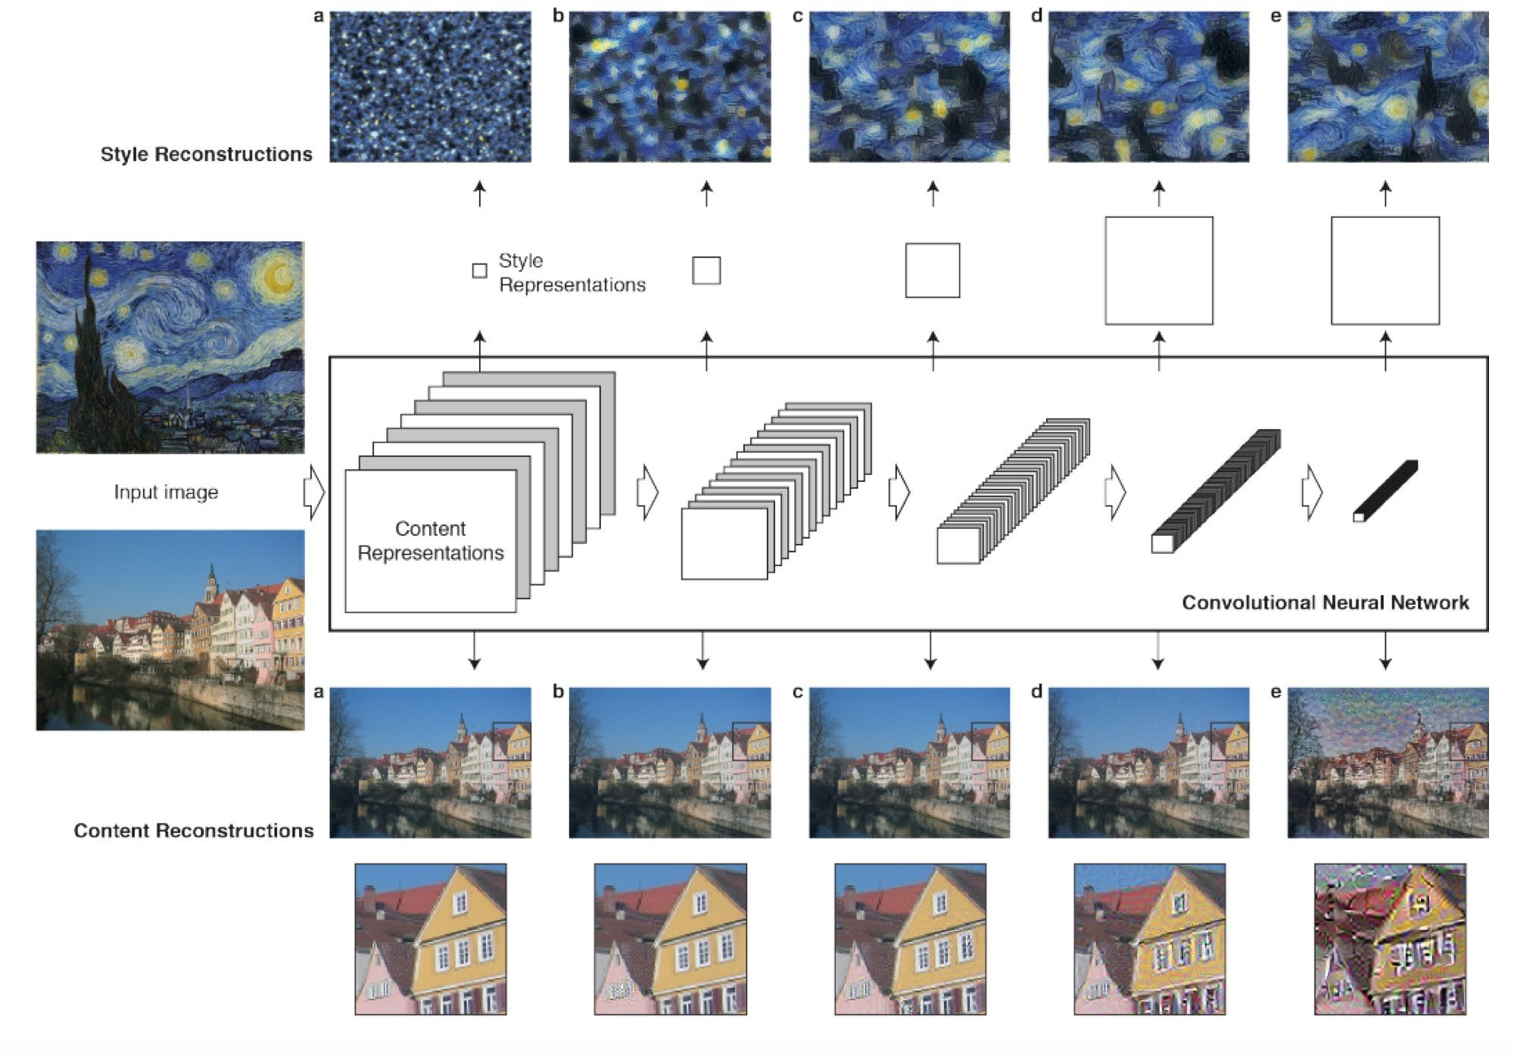
Image-Based Neural Style Transfer
Gatys et al, “A Neural Algorithm of Artistic Style”, arXiv 2015

Slide 3
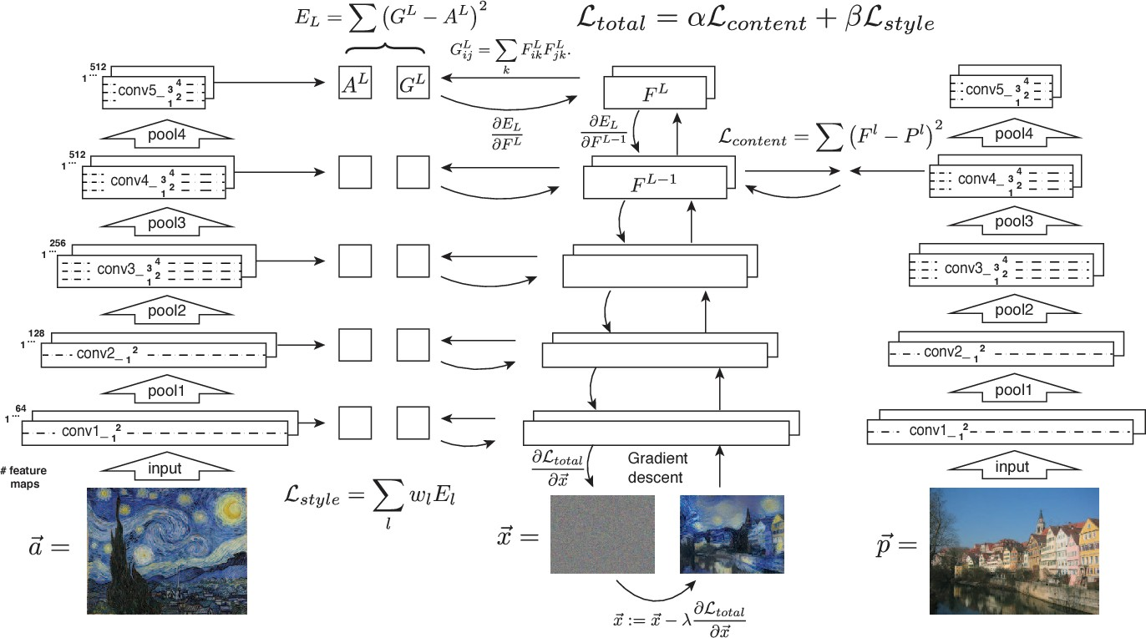
Image-Based Neural Style Transfer
Pretrain CNN (VGG)
Compute features for content image
Compute Gram matrices for style image
Clone the content image as new image
Forward new image through CNN
Compute style loss and content loss
Loss is weighted sum of style and content losses
Backprop to image and take a gradient step
Goto 5
Gatys et al, “A Neural Algorithm of Artistic Style”, arXiv 2015

Slide 4
Image-Based Neural Style Transfer
Gram Matrix
( ^{l} (I )) = [ ^{l} (I )][ ^{l} (I )]^{T}
s s s
Style Loss
☹_{s} (I_{s} , I ) =
∑
l∈{l_{s} }
l l
2
w‖
( (I )) −( (I )
‖)
l
s
Content Loss
☹ (I , I ) =‖ ^{l} (I ) −  ^{l} (I ‖) ²
c c c
Gatys et al, “A Neural Algorithm of Artistic Style”, arXiv 2015

Slide 5
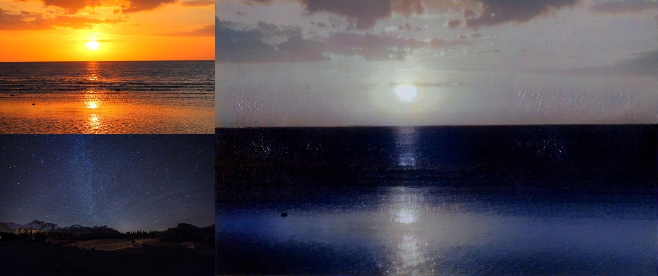
Image-Based Neural Style Transfer
Gatys et al, “A Neural Algorithm of Artistic Style”, arXiv 2015

Slide 6
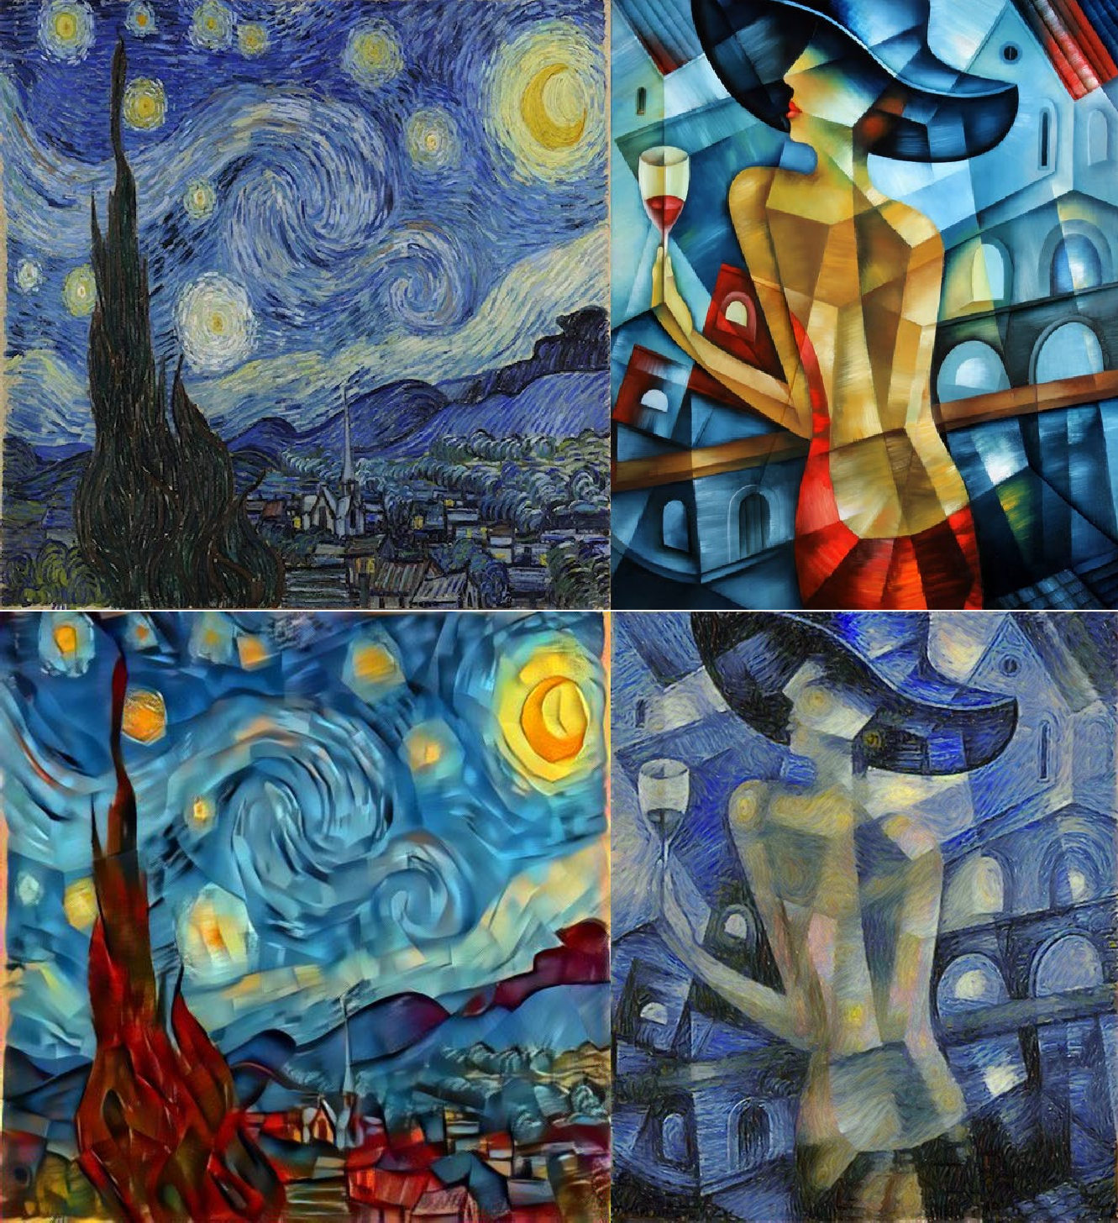
Image-Based Neural Style Transfer
Gatys et al, “A Neural Algorithm of Artistic Style”, arXiv 2015

Slide 7
Fast Neural Style Transfer
Problem: Style transfer is slow. We need hundreds of forward + backward passes of VGG-19
Solution: Train a feed forward network to perform style transfer!
Johnson et al, “Perceptual Losses for Real-Time Style Transfer and Super-Resolution”, ECCV 2016

Slide 8
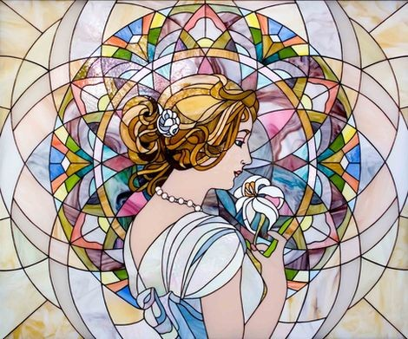
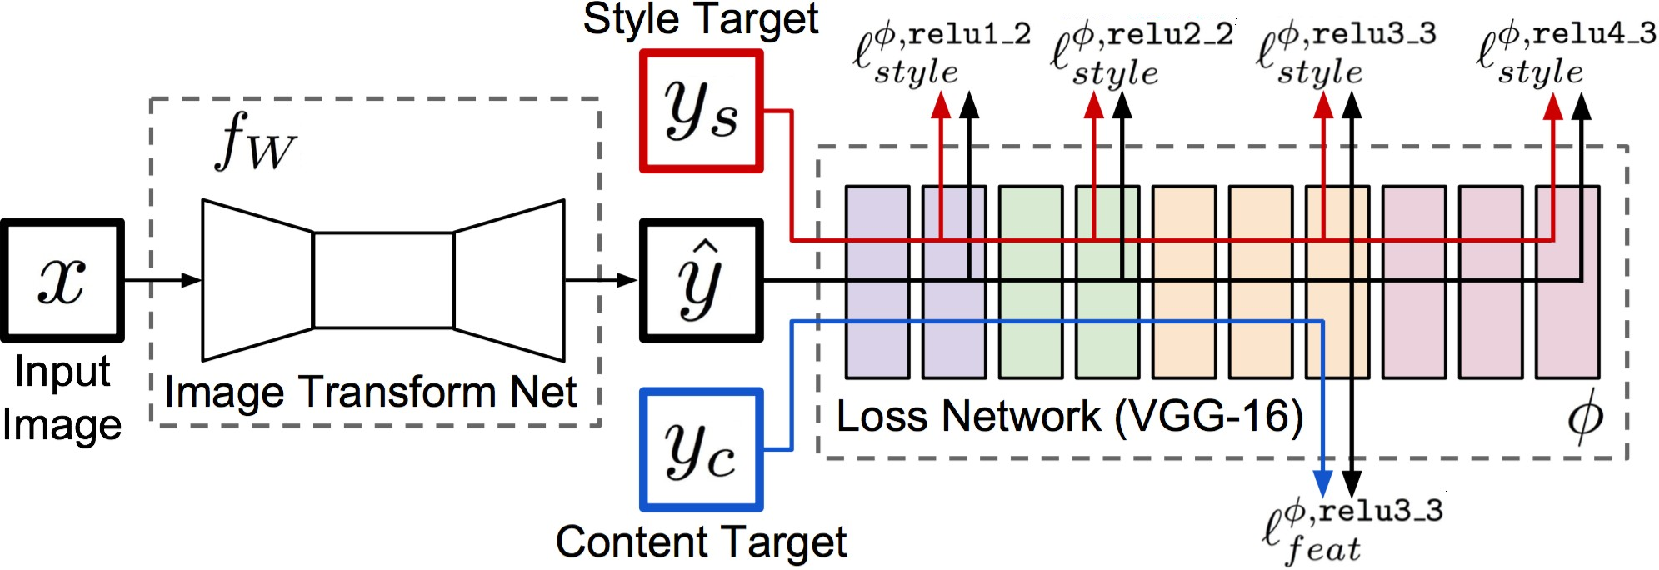
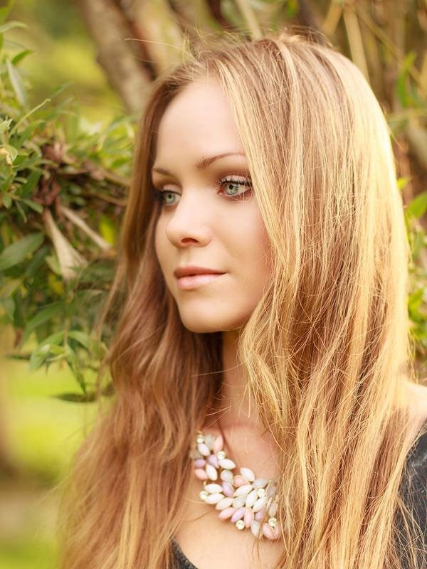
Fast Neural Style Transfer
Train a feedforward network for each style
Use pretrained CNN to compute same losses as before
After training, stylize images using a single forward pass
Johnson et al, “Perceptual Losses for Real-Time Style Transfer and Super-Resolution”, ECCV 2016

Slide 9
Fast Neural Style Transfer
Feature Reconstruction Loss
_{𝑙}φ , j
1
2
φ ( y) − φ ( y)
( yˆ, y) =
ˆ
feat
C H W
j
j
2
j j j
Style Reconstruction Loss
1
H _{j} W_{j}
φ
∑∑
φ (x)
φ (x)
G (x)
=
j
c,c
′
C H W
j
h,w,c j
h,w,c
′
j j j
h=1 w=1
_{𝑙}φ , j
( yˆ, y) = G^{φ} ( yˆ) − G^{φ} ( y) ²
style
j j
F
Johnson et al, “Perceptual Losses for Real-Time Style Transfer and Super-Resolution”, ECCV 2016

Slide 10
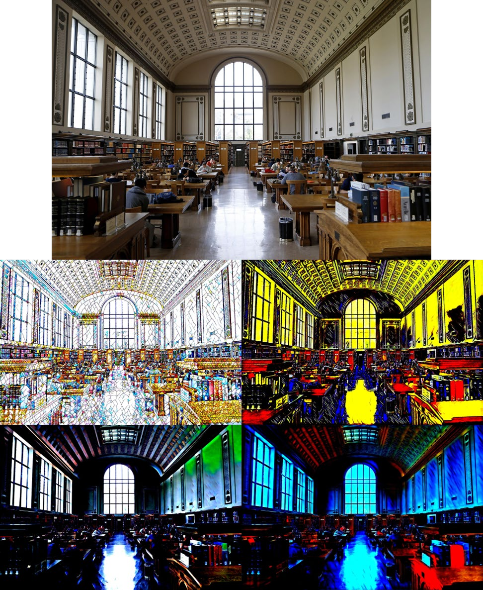
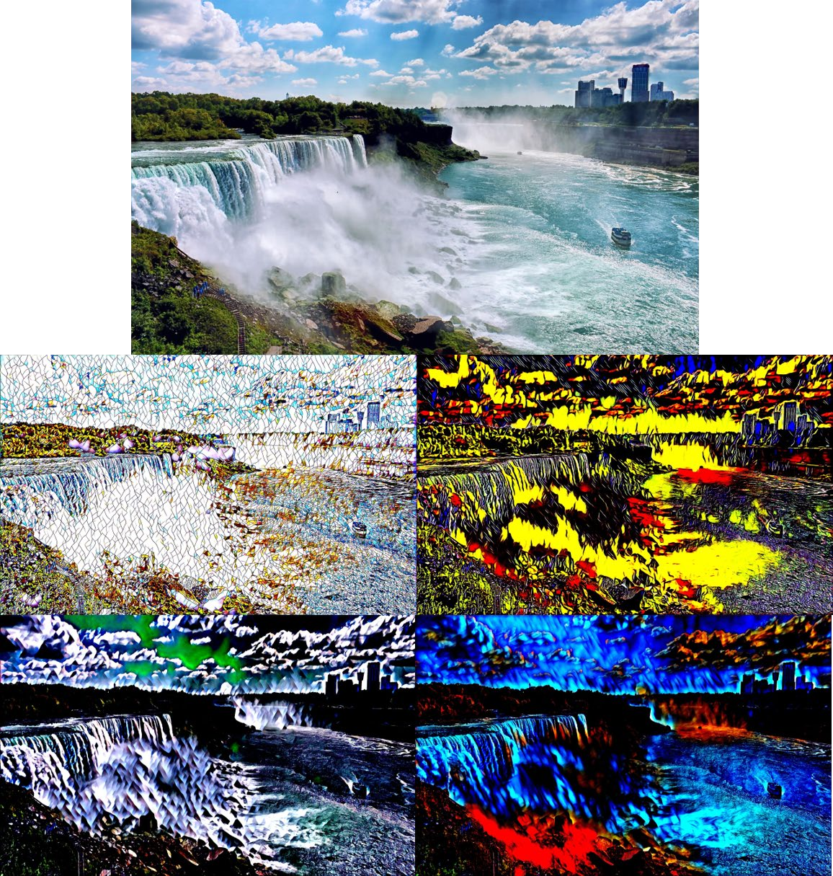
Fast Neural Style Transfer
Johnson et al, “Perceptual Losses for Real-Time Style Transfer and Super-Resolution”, ECCV 2016

Slide 11
Spring 2020, CS194-26 Final Project
Thank you!

